Slide 1
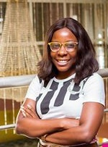
Bimbo Akinsanya
Abimbola Esther Akinsanya, a Graduate of English language from Obafemi Awolowo University. A Christian and was born into a very humble family of 8. 5 siblings and parents. Grew up in Ebute Meta area of Lagos, and has a strong interest in Charity, media and communications.
She runs a Ngo called Lend a Hand for the Development of Africa formerly called Bimbo and friends. We hope to fill the void created by the inadequate access to quality education and health materials in local communities. We do this by giving educational and health support/supplies to young adults in various local communities. We have been able to reach out to over 5000 people, and we have different schools and communities as our adopted centres.

Slide 2
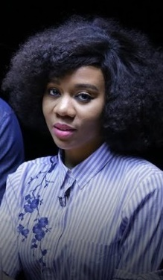
Omotayo Adeola
Firecatcher 🔥
Facilitator @a.womanswealth Doodles @silly.print Fellowships at @ignitegla Producer + Co-Host @hotmtv

